Slide 1
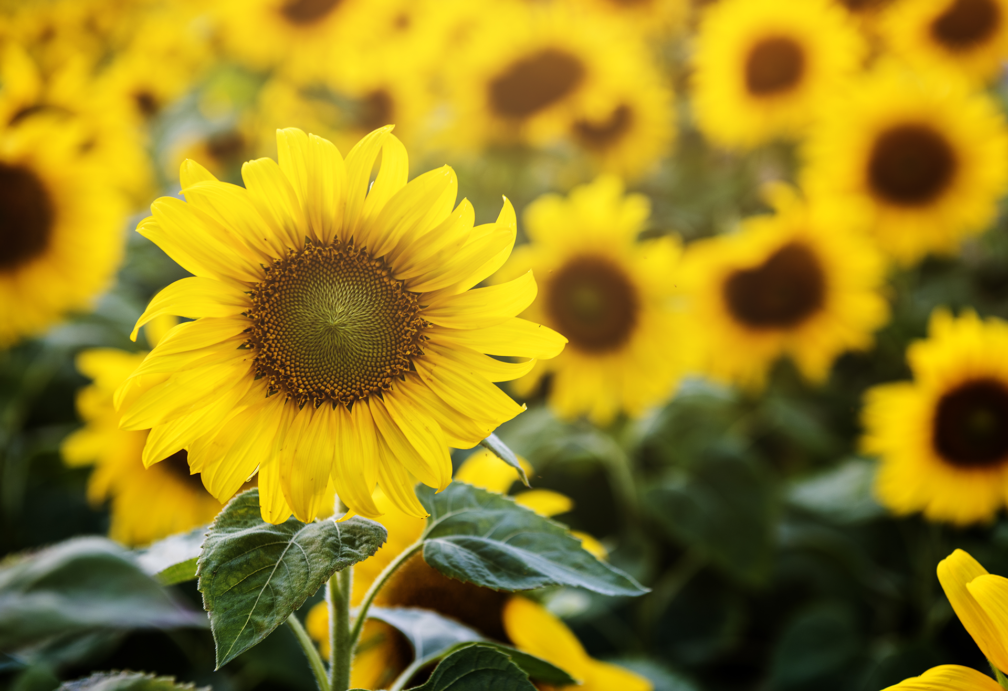

The Coffee and the Bees
Wojciech Simon Waliszewski Ph.D.

Slide 2

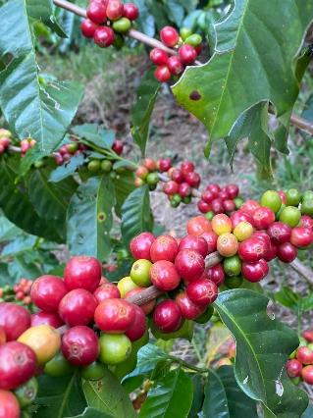
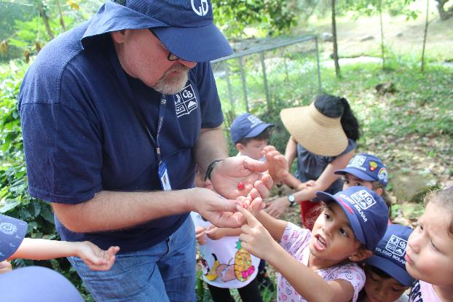
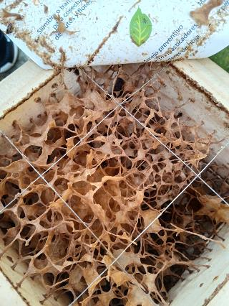

How to build community, break down barriers, encourage vocational learning and inspire students to develop their own projects.
Lessons learnt from building a school garden.

Slide 3

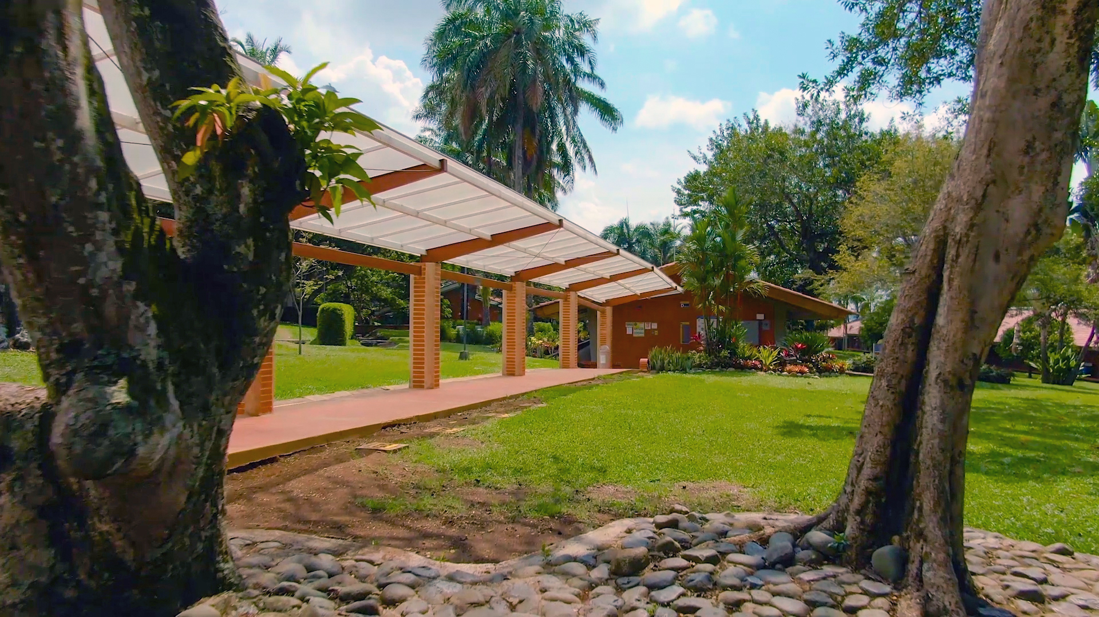


But first sit back, relax and enjoy
Have you written your name and entered it in for the Don Simón raffle?
Tri Association video

Slide 4
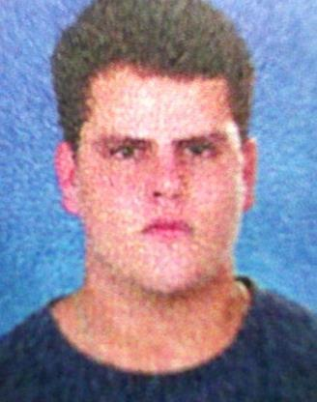

Mission
To create a communal space where our school community can come together to learn about agriculture from one another using a hands-on approach and have fun and enjoy their time together in nature.
An outside laboratory
Building awareness of food
Building community
Project based learning
A need for more “hands on learning”

Slide 5

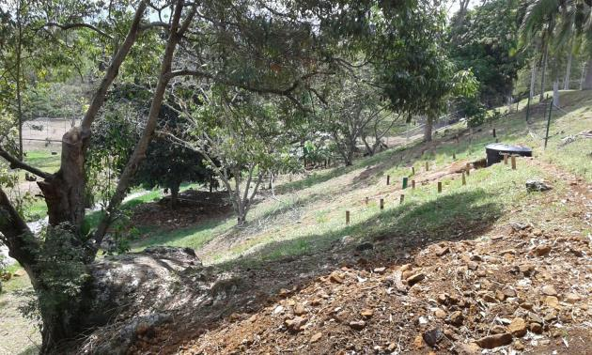

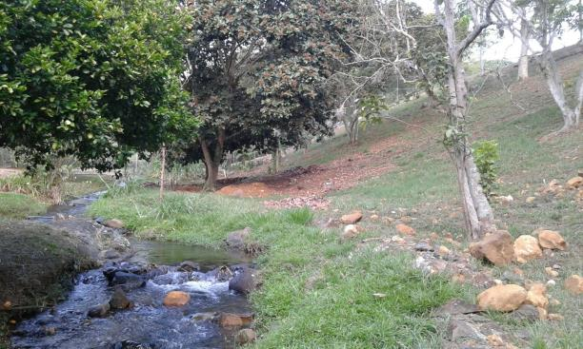
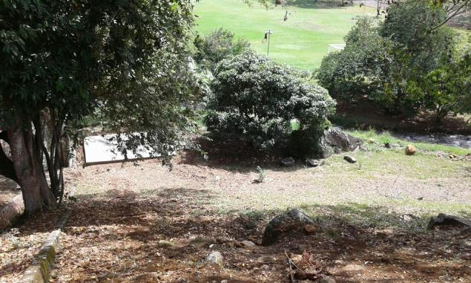

August 2015 – Initial discussions with admin
September 2015 – location with Dr Nagy
October 2015 – site maps
November 2015– visit with School Engineer

Slide 6
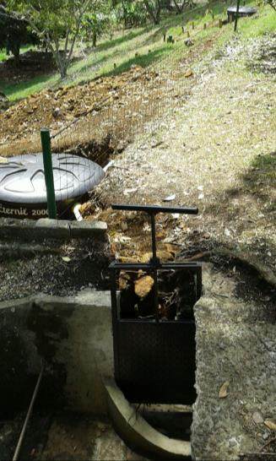
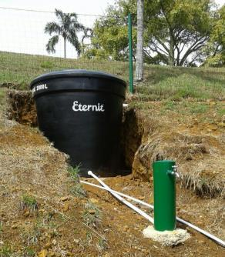
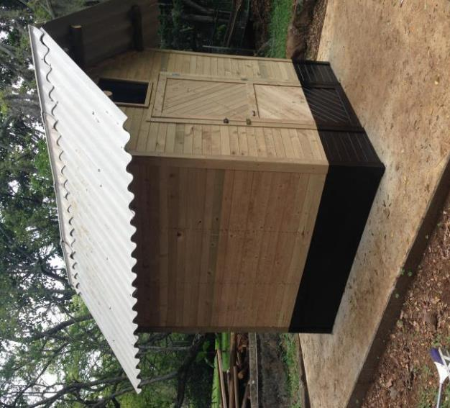
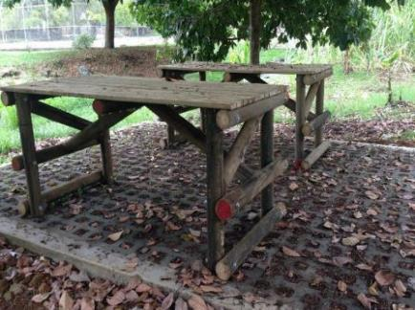
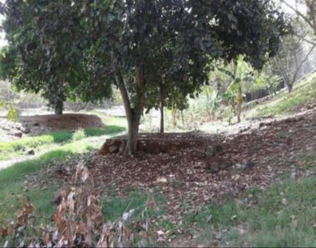
Infrastructure
January to March 2016

Slide 7

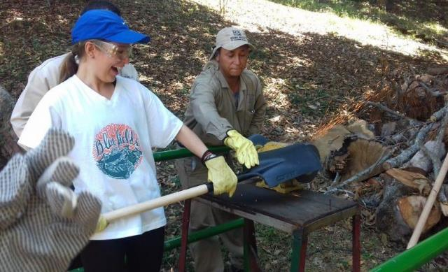
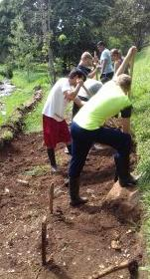
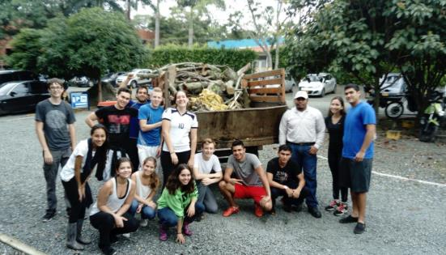
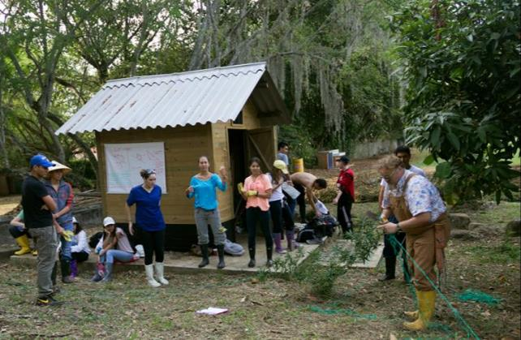

Year 1 August 2016 – June 2017
Agricultural science elective

Slide 8
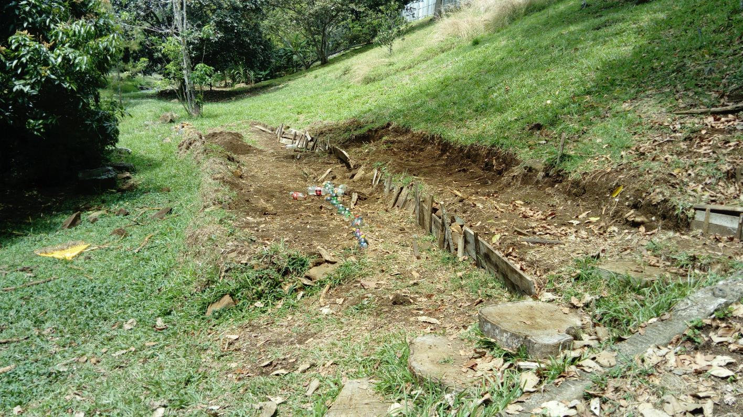
Year 1 August 2016 – June 2017
Doesn´t look like a lot of work, but it was!

Slide 9

YEAR 2 – 2017-2018 – starting to take off
Start of the coffee plantation
Planning
Setting out
Nursery development
Maintenance
Planting
Increased community involvement through BGS
First field trip to Agrosavia – gene bank of Harton del Valle; arboretum of tropical trees; introduction to Cacao.

Slide 10
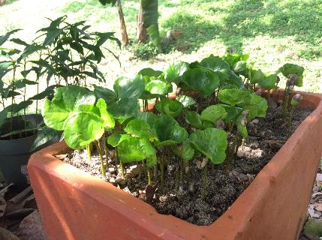
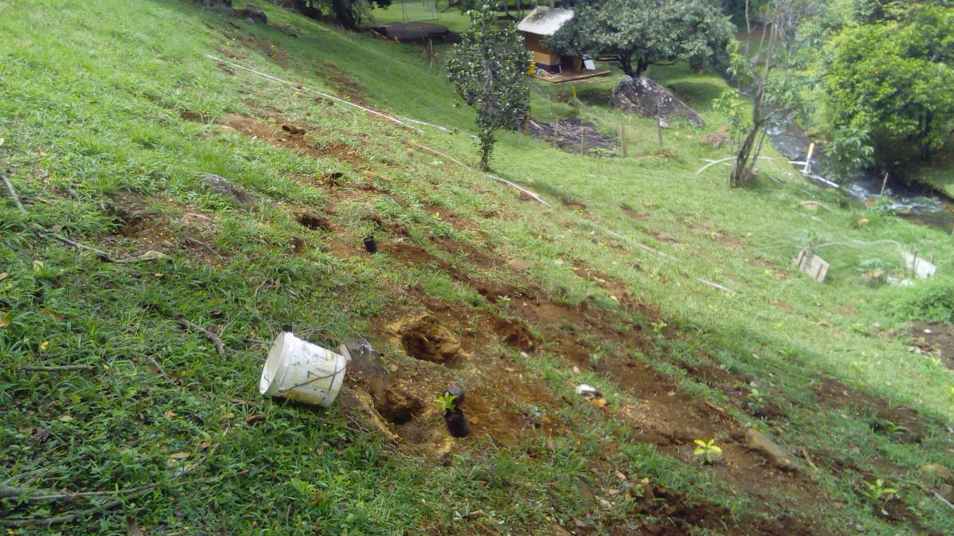
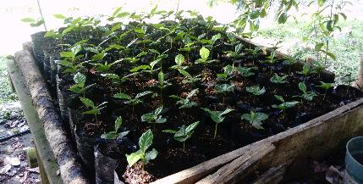
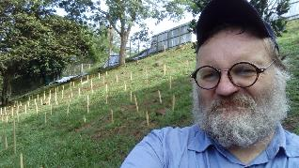
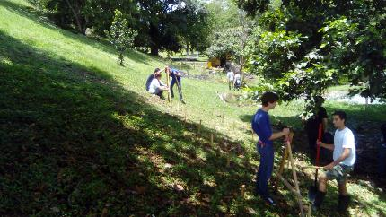
YEAR 2 – 2017-2018

Slide 11
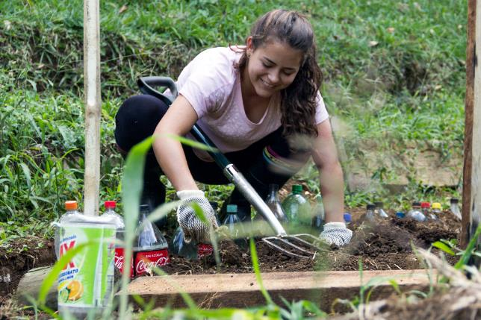
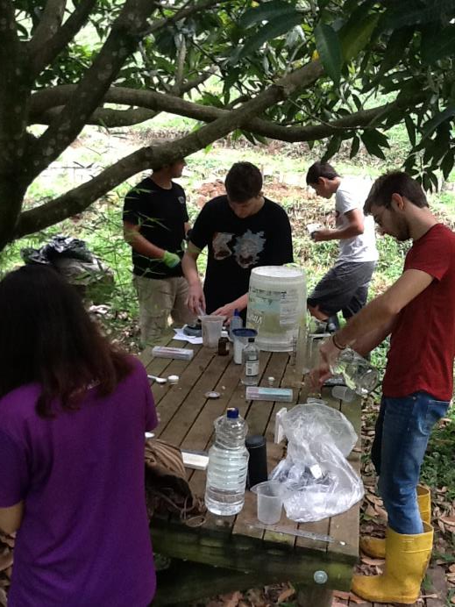
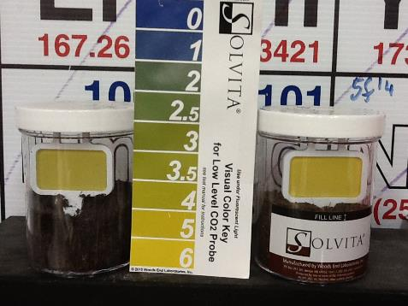
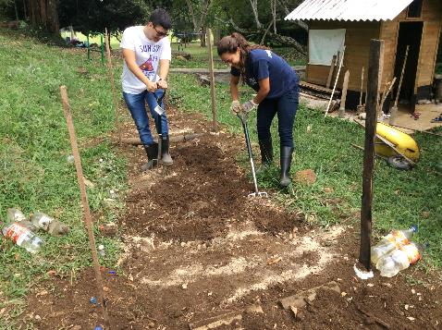
2nd Year Ag. Sci.

Slide 12

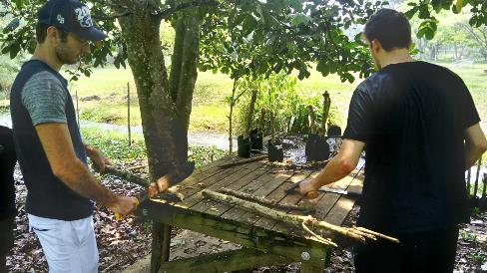
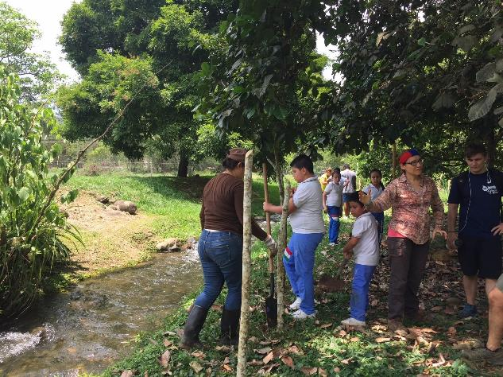
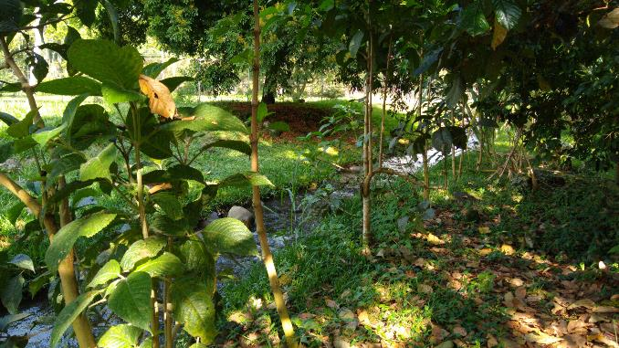
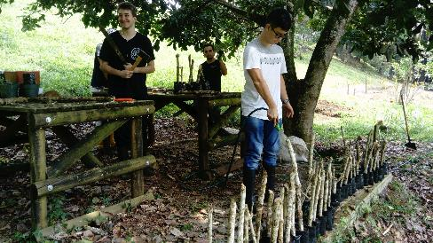
Planting of nacedero, Trichanthera gigantea

Slide 13

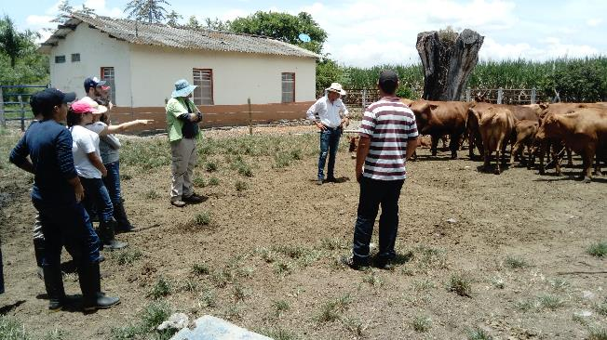
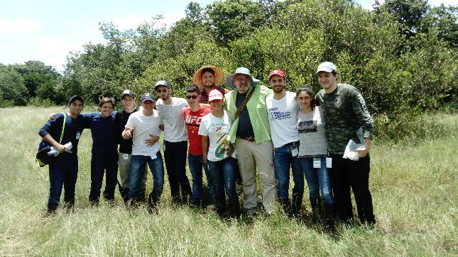
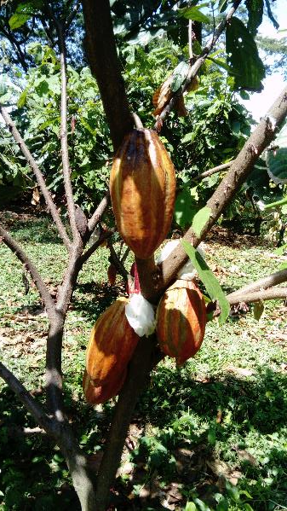
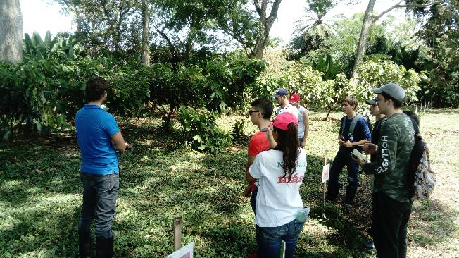
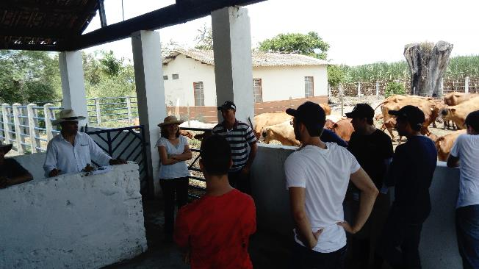
Making links with our wider community.

Slide 14
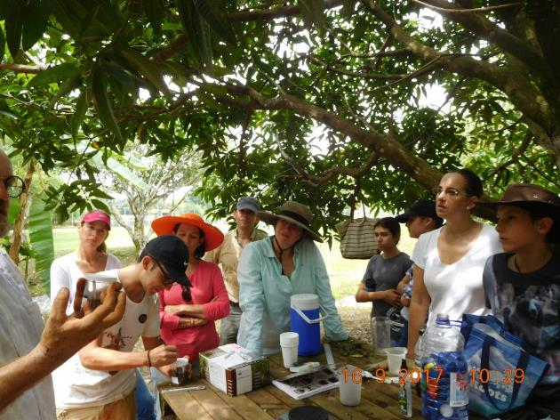
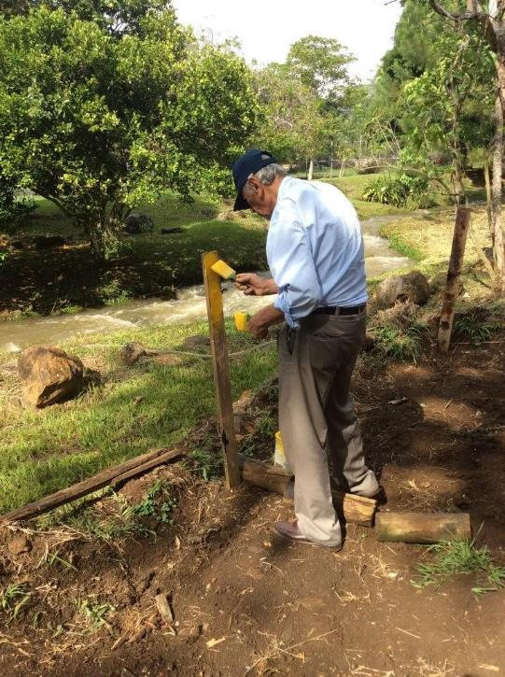
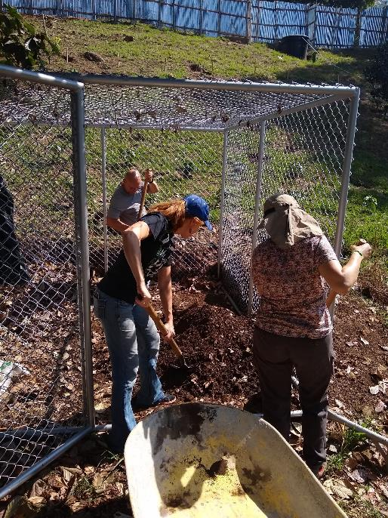
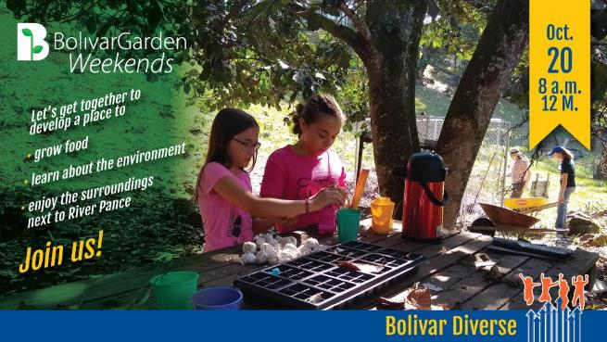
Building community – Bolivar Garden Saturdays

Slide 15
Year 3 – 2018 - 2019
A momentous year!
Plantain
Gliricidia sepium – Mata raton
Maize
Compost starting off – nacadero coming in to its own
BGS getting stronger
Social service
First visit to garden by outside teachers
Tea Plantation visit
7 Rios fest – outreach to the wider community

Slide 16
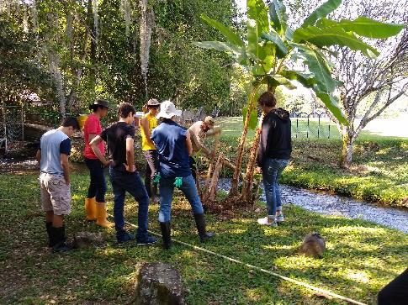
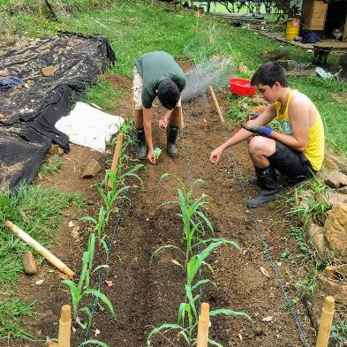
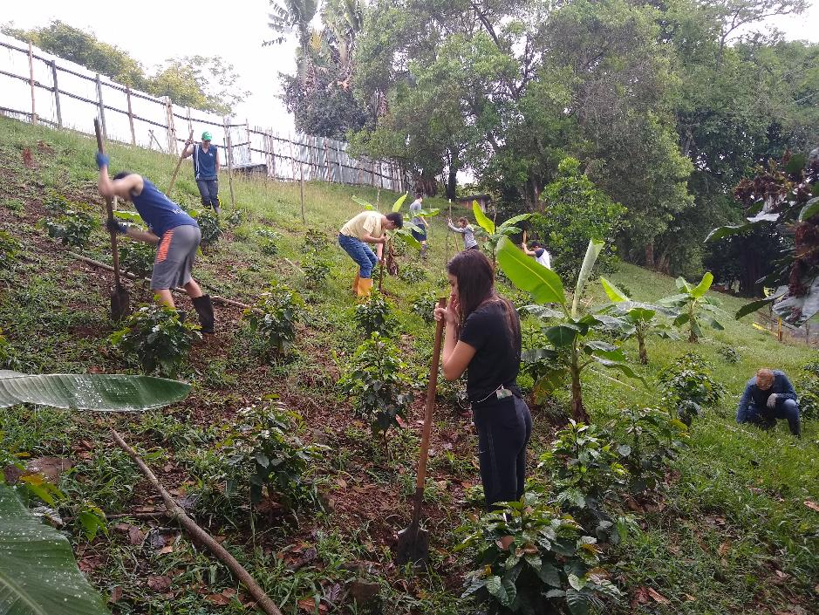
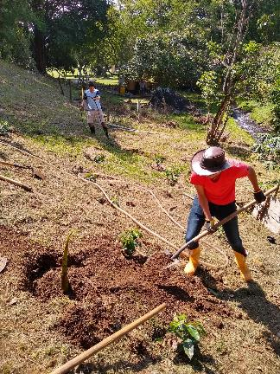
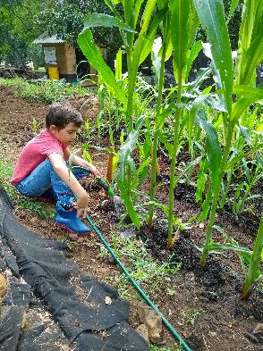
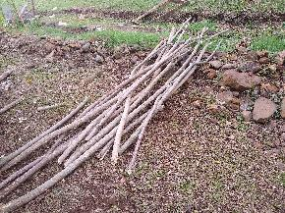
3rd Year Ag. Sci.

Slide 17
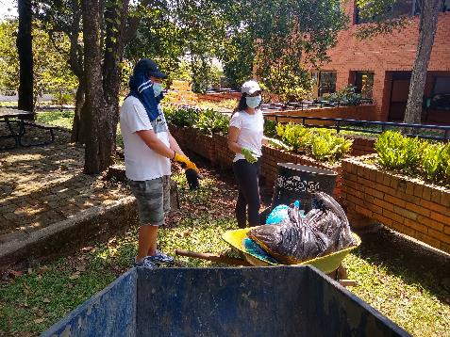
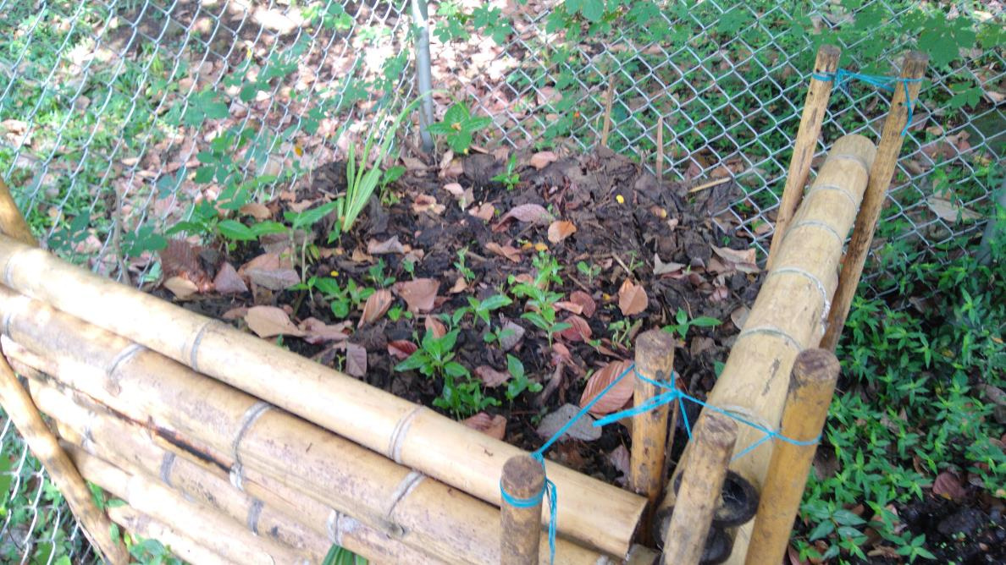
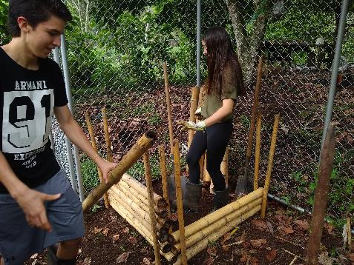

Composting

Slide 18




Building community

Slide 19



Building community - Social Service
Cotolengo Old People´s home, and winners of the first Coffee Bean Count!

Slide 20



Outreach and educating the wider community
7 Rios Festival
Students teaching the public about our efforts to protect our tranche of the Rio Pance using trees.
The presentation was given at the 7 Rios festival in Cali.

Slide 21







Tea Plantation visit

Slide 22
Year 4 – 2019 - 2020
Don Simón, Sweet Potatoes & Students
First coffee harvest and start of DON SIMÓN
GIN conference
Sweet potato field visit
Sweet potato student project - outreach
Student visits from Primary
5K race and cacao
Coffee talks

Slide 23





4th Year Ag. Sci.

Slide 24



DON SIMÓN STARTS

Slide 25





Building leadership in students
The Sweet Potato Project
Following a GIN conference Juan Manuel Sanabria connected with Dr Genoveva Rossel and set up a sweet potato project to ensure food security for an old people’s home, Cottolengo.
GIN and Ag. Plant. Sci. Students on a joint field trip to a sweet potato farm

Slide 26



Academic Integration - GIN
GIN students have used the garden as a springboard for sustainability projects for CB and institutions supported by CB
GIN and Ag. Plant. Sci. Students working to prepare the terrace for sweet potatoes

Slide 27





Academic Integration - GIN
GIN students taught Cottolengo residents how to plant and sustainably grow Camote
Cottolengo residents are producing sweet potato to this day.

Slide 28


Academic integration – getting primary involved.

Slide 29

Academic integration - K4 students
K4 students and with Luz Adriana Serna learning about soil types. (2019)

Slide 30


Academic integration – 1st Grade
Agriculture students teaching 1st grade students how plants get nutrients

Slide 31


Academic integration – 3rd Grade
3rd grade students learning about composting and the roles of worms and heat in this process (2019)

Slide 32


Academic integration – 5th Grade
Data collection of coffee plant development in 5th grade science

Slide 33

Academic integration – 8th Grade
8th grade students using the garden as a basis for thinking of their Shark Tank Sustainability projects. Teacher Ms Annie Christy and STEM coach Ms. Imogen Herrick are in the photo. (2017)

Slide 34




Building community
5K Verde Race
Teachers, students and other community members planting coffee and cacao trees during the school’s 5K race

Slide 35




YEAR 5 – the fallow year 2020-21
Pandemic year so no ag. science elective and no BGS.
Minimal maintenance by Hugo.

Slide 36

YEAR 6 – 2021-22 – return & student leadership
Maintenance of the garden
Coffee collection and sale
Don Simon Coffee Club
Honey project
Greenhouse project
Expert visits – Fernando Oka
Tri-Association Community Award

Slide 37




BUILDING LEADERSHIP IN STUDENTS
The Don Simón Coffee Club
Marketing of coffee
Responsibility for sales
Revenue funds the garden´s activities

Slide 38




BUILDING LEADERSHIP IN STUDENTS
La Colmena – A social enterprise
Three agriculture students set up a social enterprise to help honey producers, increase the population of Melipona sp. and have a positive impact on the environment.

Slide 39




BUILDING LEADERSHIP IN STUDENTS
The Greenhouse Project
Three years ago, three 8th grade students won the “Shark Tank sustainability project” building a greenhouse for the school.
After the pandemic they worked to produce plans for the greenhouse and worked to find funding.

Slide 40




BUILDING COMMUNITY
Learning from the experts
Fernando Oka of OKA Roasters talking about roasting and management.
Ex Alumni, Alex Aruajo, teaching about coffee quality

Slide 41



YEAR 7 – 2022-2023
75th Anniversary celebrations & the future
Academic integration continues
Don Simón continues to grow
Irrigation project
The CB Flora Project
The 75 tree project
Cacao 7- 8 year primary project
Plantain maintenance
Greenhouse inauguration

Slide 42







YEAR 7 – 2022-2023
75th Anniversary celebrations & the future
Dra. Luz Amalia teaching agri.plant sci. students about measuring trees.
Discussions about carbon capture – form factors.
Maps zoning out the campus for student work.

Slide 43

YEAR 7 – 2022-2023
75th Anniversary celebrations & the future
Students are in the process of pegging out where our future cacao plantation is going to go, and where plantain and banana will be grown to provide short to mid term shade

Slide 44




YEAR 7 – 2022-2023
75th Anniversary celebrations & the future
BGS keeps getting stronger. Photos from our latest BGS on the 17th September

Slide 45



YEAR 7 – 2022-2023
75th Anniversary celebrations & the future
Don Simón Club already planning ahead for the first sale of our 6th Harvest, on the 1st October.

Slide 46




CONTINUED ACADEMIC INTEGRATION
AGRICULTURAL PLANT SCIENCE
+ 80 students in 11th and 12th grade have been through the agriculture elective + 3 senior projects
Monograph projects on specific plant species. University level research.
Hands-on learning

Slide 47




Building community
FEEDING OUR COMMUNITY

Slide 48


BUILDING COMMUNITY
RESPECT AND RECOGNITION
Everyone can learn from one another
The school´s gardeners have come to lessons to learn with our students as well as share their valuable knowledge, often being called “Profe” by the students.

Slide 49
BUILDING ENVIRONMENTAL AWARENESS FROM THE START AND TOWARDS THE FUTURE
Food security
Erosion
Origins of food
Protection of water sources
Shade as an important component of local climate
Reuse
Composting

Slide 50
LESSONS LEARNT
Ask, ask, ask
Reach out to institutions, specialists in the community
Reach out to the school community
Get project integrated into school curriculum and community office, teacher parent association
Encourage cross-curricular work with other classes.
Think big…and then scale back
Be flexible and patient
Celebrate small achievements – recognize the efforts of others
Keep positive
Get on very well with your head of maintenance
Recognize mistakes, take responsibility, be safe and polite, and …

Slide 51




…IF YOU CAN, HAVE A BARBIE AFTER WORKING HARD!

Slide 52
YEAR 7 – Tri – Association Conference
Almost done, just one more thing…

Slide 53



YEAR 7 – Tri – Association Conference
RAFFLE TIME!

Slide 54

¡Gracias! Thank you!

